Slide 1
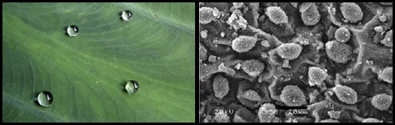
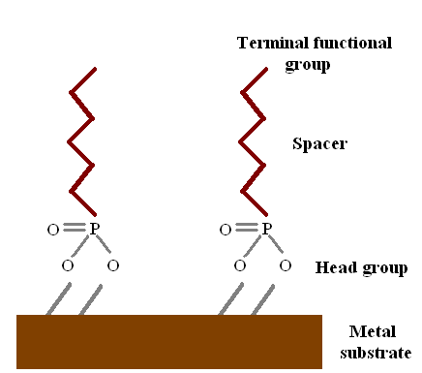
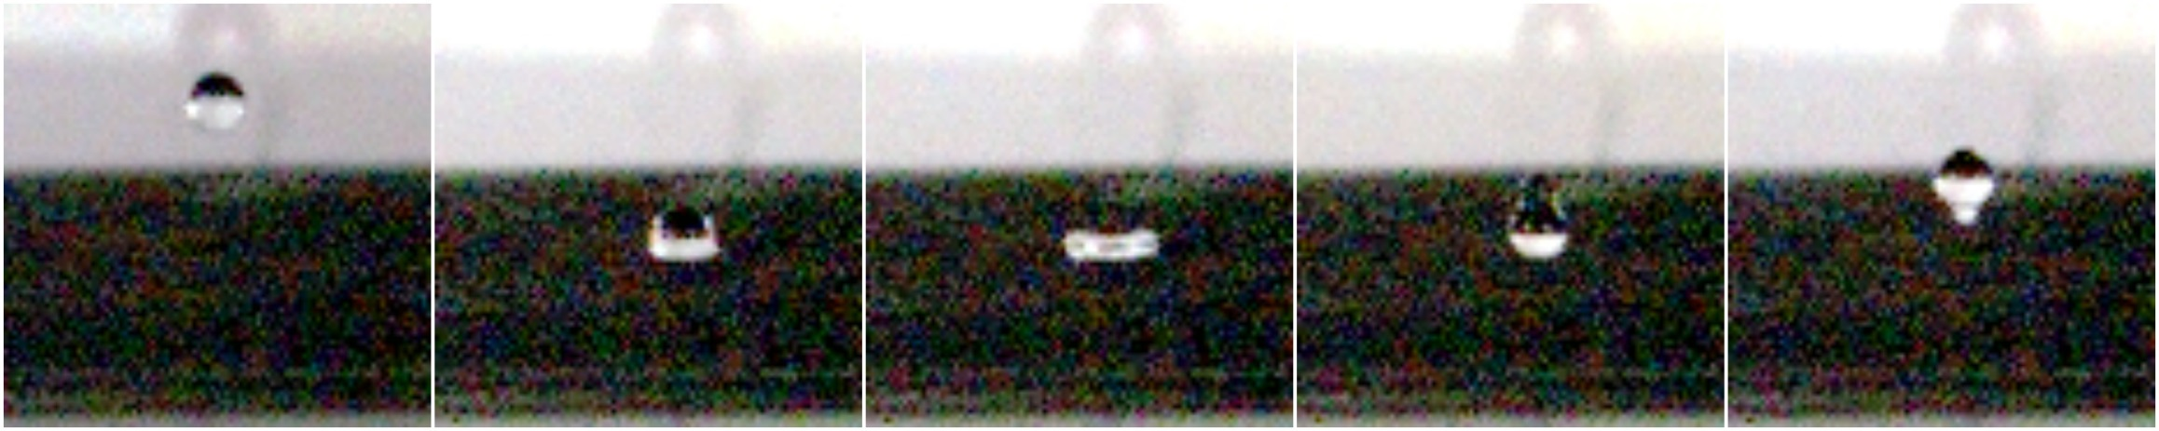
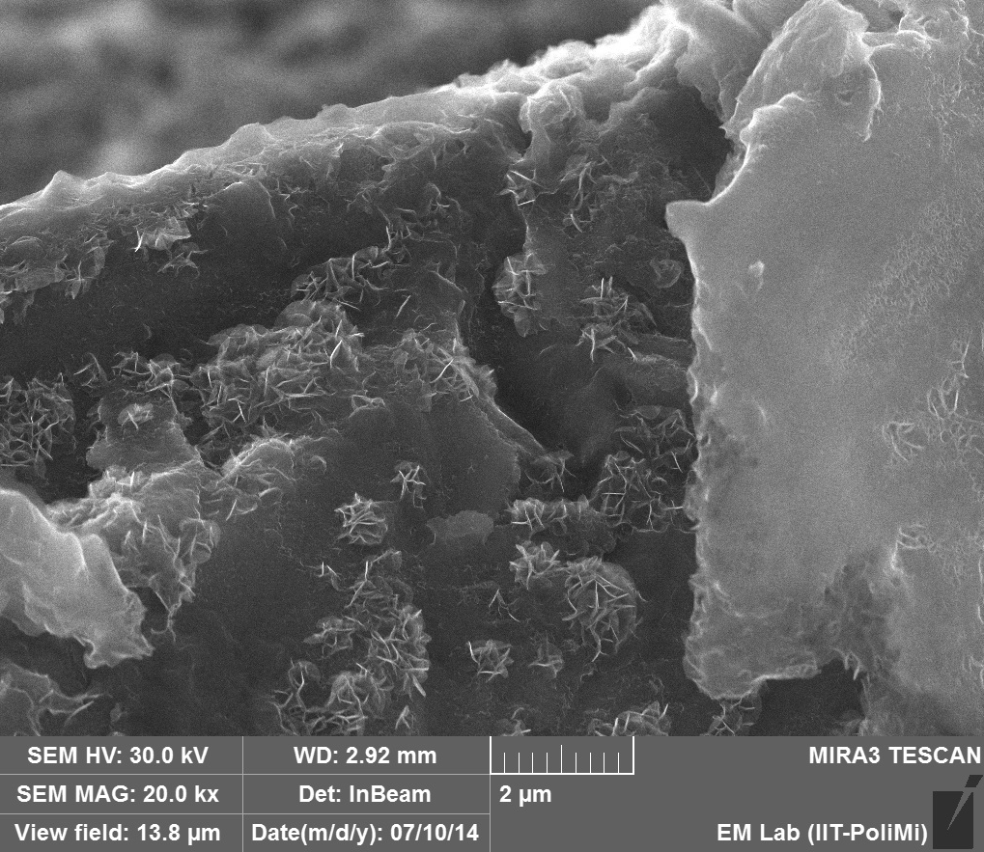
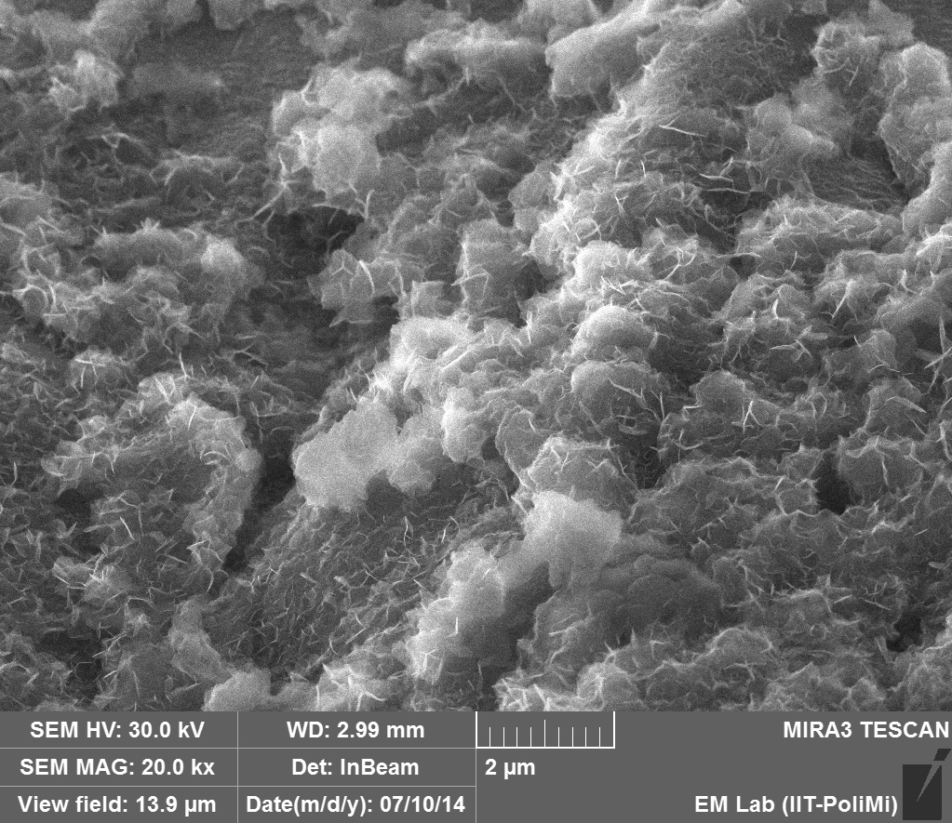
SUPERHYDROPHOBIC COATINGS OBTAINED BY SELF-ASSEMBLED MOLECULES FOR INDUSTRIAL APPLICATION
Sara Ottoboni*, Amani Ponzoni*, Mirko Pinali, Paolo Gronchi
*Politecnico di Milano, Chemistry, Material and Chemical Engineering Dept. «Giulio Natta», P.za Leonardo da Vinci, 32 20133 Milano, Italy. E-mail: saraottoboni@polimi.it
SUPERHYDROPHOBICITY is a distinctive characteristic of surface structure that shows extreme water repellency.
The peculiarities observed in a superhydrophobic surface (SHS) are:
wettability that shows contact angles θ between 150° and 180°;
the presence of a hierachial micro- and nano-scale surface roughness (texture);
low surface energy.
AIM OF THE WORK
low production cost SHS;
SHS easy to produce;
Large SH surfaces;
Durability.
PARAMETERS THAT INFLUENCE SHS
Roughness R Surface tension ϒ
ϴ = f (R,ϒ)
Taro leaf.
ELEMENT | PERCENTAGE (%)
C | 0.04
Si | 0.01
Mn | 0.24
Cr | 0.02
Mo | < 0.01
Ni | 0.02
Cu | 0.02
V | < 0.001
1) ROUGHNESS: Modify the surface topography
Sandblasting procedure is used to modify the roughness: an homogeneous and highly controlled topography can be obtained.
SUBSTRATE | Ra | Rq | Ry
 | (nm) | (nm) | (nm)
Untreated | 207.2798 | 284.1233 | 2893.575
Sandblasted | 291.5657 | 371.0363 | 2667.543
Mild carbon steel is used in our work to cut the SH materials production costs.
2) SURFACE TENSION: Creation of hydrophobic coatings
SPACER:
C4, C12, C18
HEAD GROUP:
Phoshonic group
TERMINAL GROUP:
Methyl group
METAL SUBSTRATE:
Steel
DEPOSITION PROCEDURE
SUBSTRATE PRETREATMENT
  Rinsing with polar solvent (grease removal)
  Surface activation with Nochromix solution (sulfuric acid + oxidant agents) @ t = 1’, 3’, 6’ (creation of surface active sites)
  Rinsing with water (to remove the Nochromix residues)
SELF ASSEMBLED MOLECULES (SAM) DEPOSITION: 1mM of SAM in tetrahydrofuran (THF) @ t = 22h (the deposition process needs enough time to adsorb and organise the SAM onto the substrate)
POST TREATMENT
  Thermal treatment @ T = 110°C and t = 1h (to enhance the bond strength between subsbtrate and SAM in order to move from Van der Waals forces to quasi-covalent bonds)
  Rinsing with THF (to remove the SAM excesses)
RESULTS
SPACER | SANDBLASTING
 | UNTREATED SUBSTRATE | SANDBLASTED SUBSTRATE
 | ϑ _{avg} (°) [St. dev] | ϑ _{avg} (°) [St. dev]
C4 | 88 [20] | 139 [2]
C12 | 103 [17] | 157 [5]
C18 | 147 [5] | 164 [6]
SPACER | ETCHING TIME
 | 1min | 3min | 6min
 | ϑ _{avg} (°) [St. dev] | ϑ _{avg} (°) [St. dev] | ϑ _{avg} (°) [St. dev]
C4 | 139 [2] | 136 [5] | 145 [4]
C12 | 157 [5] | 167 [2] | 170 [4]
C18 | 164 [6] | 137 [18] | 100 [11]
SPACER | POST THERMAL TREATMENT
 | 6min
 | ϑ _{avg} (°) [St. dev]
C4 | 145 [1]
C12 | 175 [4]
C18 | 172 [7]
The roughness control by sandblasting increases the hydrophobicity and the homogeneity of the samples coating.
Etching time influences the amount of active sites onto the substrate: the higher the number of available active sites the higher the number of anchored SAM molecules is obtained; SAM with C18 spacer shows an opposite trend: lowering of contact angle with increasing etching time can be explained by the bending of the alkylic chain due to its eccessive length.
The presence of a post thermal treatment can induce a further increase of superhydrophobicity.
SPACER | CONTACT ANGLE ϑ _{avg} (°) [St. dev] |  | SURFACE TENSION ϒ (mN/m) |  |  | ADHESION FORCE Fa (nN)
 | WATER | FORMAMIDE | ϒ_{S}^{d} | ϒ_{S}^{p} | ϒ_{S} | Fa
C4 | 145 [1] | 140 [4] | 0.7203 | 0.1326 | 0.8529 | 20.335
C12 | 175 [4] | 153 [2] | 1.1365 | 0.4684 | 1.6048 | 16.535
C18 | 172 [7] | 156 [2] | 0.6235 | 0.2224 | 0.8459 | 20.040
Bouncing studies show a complete rebound that means the presence of a Cassie state SH, in accordance with the low dynamic hysteresis contact angle.
In agreement with experimental data the surface tensions are low.
CONCLUSIONS
The target of cheap, easy and fast superhydrophobic coating production is achieved; this technique can be applied to large scale surfaces and for complex samples due to the fact that it is a dipping deposition method;
In accordance to the results, the best choice is to produce SHS by applying a C12 spacer hydrophobic coating onto a sandblasted substrate, 6min etched, followed by a post thermal treatment;
Adhesion force data do not allow the prediction of the SHS durability;
Nowadays there are not standard analytical methods to determine durability.
The SEM images show a complete coating of the substrate and also the presence of a micro- and nano-scale roughness are observed.
G., V. A. (1999). Self-assembled monolayers on engineering metals: structure, derivatization, and utility. Langmuir, 7605-7614.
Ghassamipour S., S. A. (2009). Friedlander synthesis of poly-substituted quinolines in the presence of dodecylphosphonic acid (DPA) as a highly efficient, recyclable and novel catalyst in aqueous media and solvent-free conditions. Tetrahedron letters, 514-519.
Lam C. N. C., W. R. (2002). Study of the advancing and receding contact angles: liquid sortion as a cause of contact angle hysteresis. Advances in colloid and interface science, 169-191.
Lim M. S., S. K. (2010). Thermally driven stability of octadecylphosphonic acid thin films grown on SS316L. Scanning , 304-311.
Rioboo R., T. C. (2001). Outcomes from a drop impact on solid surfaces. Atomization and sprays, 155-165.
Yan Y. Y., G. N. (2011). Mimicking natural superhydrophobic surfaces and grasping the wetting process: a review on recent progress in preparing superhydrophobic surfaces. Advances in colloid and interface science, 80-105.
Zhang X., W. N. (2013). Superhydrophobic surfaces for the reduction of bacterial adhesion. RCS advances, 12003-12020.

